Slide 1
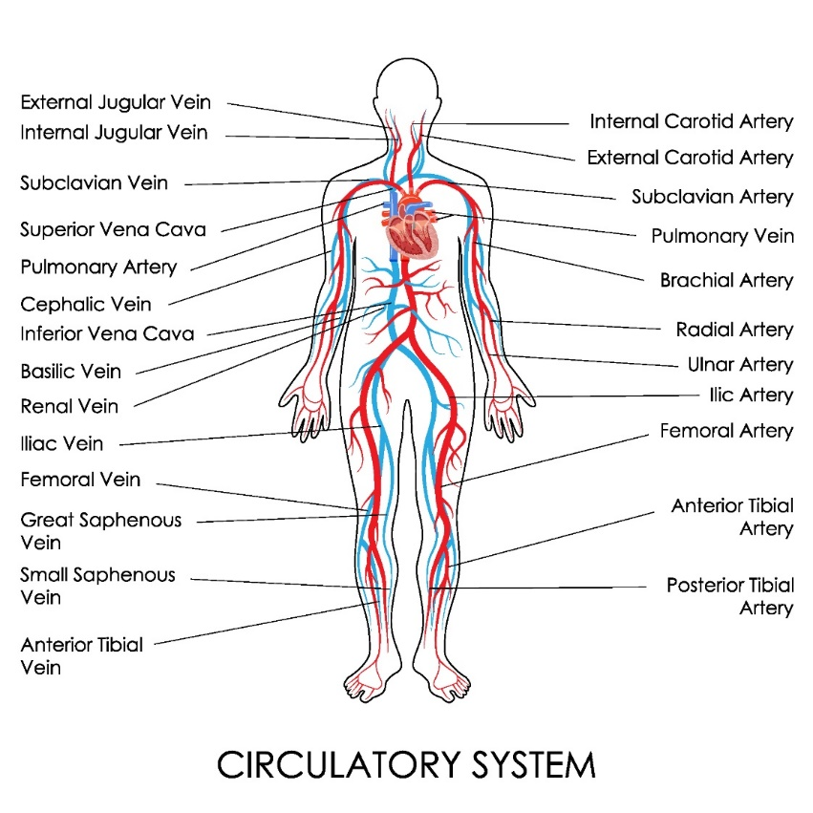
Chapter 5 Cardiovascular system

Slide 2
Heart 4 chambers
Heart valve and septum
2 Atrium and 2 ventricle

Slide 3
Right atrium from superior vena cava and inferior vena cava via tricuspid valve
Right ventricle ot pulmonary artery via pulmonic value or semilunar valve

Slide 4
Left atrium by pulmonary vein via mitral valve
Left ventricle to aortic value and aorta

Slide 5
Aorta
Ascending aorta
Arch of aorta
Descending aorta as thoracic aorta and abdominal aorta

Slide 6
Carotid artery
Artery
Arteriole
Capillary
Jugular vein
Superior vena cava

Slide 7
Inferior vena cava
Vein
Bone marrow

Slide 8
Spleen
Splenectomy

Slide 9
Questions?

