Slide 1
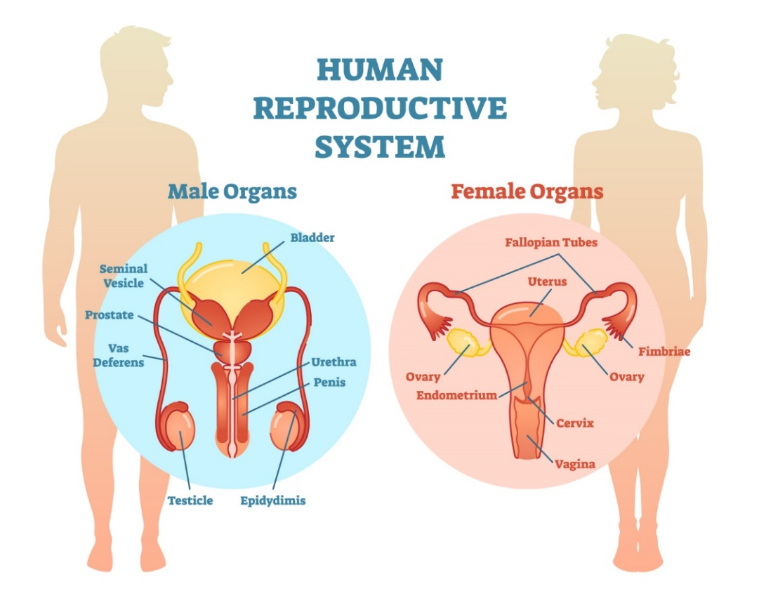
Chapter 6 Reproductive system

Slide 2
Anus
Bladder

Slide 3
Cervix
Adnexa
Fallopian tube
Glans penis and prepuce
Labia majora
Labia minora
Mon pubis and pubic hair

Slide 4
Ovary
Estrogen and progesterone
Penis
Prepuce
Circumcision

Slide 5
Pubic hair
Scrotum
Testis

Slide 6
Urethra
Urethral opening
Glans penis

Slide 7
Uterus
Endometrium and menstruation
Vagina

Slide 8
Questions?

