Slide 1
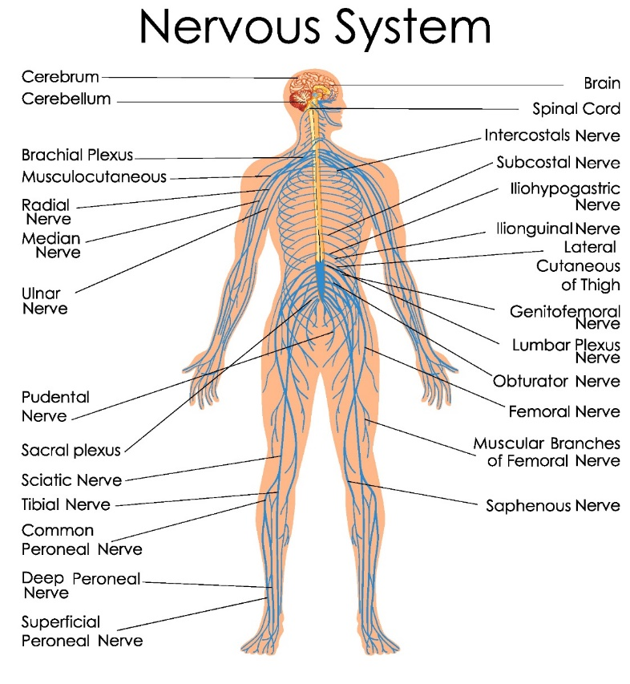
Chapter 7 Neurological system

Slide 2
Brain
Cerebrum

Slide 3
- Dura
- Arachnoid
- Pia

Slide 4
Cerebellum
Brain stem
Cranial nerve

Slide 5
1. Olfactory nerve (CN I) (sensory neuron)
2. Optic nerve (CN II) (sensory neuron)
3. Oculomotor nerve (CN III) (motor neuron)
4. Trochlear nerve (CN IV) (motor neuron)
5. Trigeminal nerve (CN V) (mix neuron)
Frontal branch
Maxillary branch
Mandibular branch

Slide 6
6. Abducens nerve (CN VI) (motor neuron)
7. Facial nerve (CN VII) (mix neuron)
8. Vestibulocochlear nurse or Auditory nerve (CN VIII) (sensory neuron)
9. Glossopharyngeal nerve (CN IX) (mix neuron)

Slide 7
10. Vagus nerve (CN X) (mix neuron)
11. Accessory nerve (CN XI) (motor neuron)
12. Hypoglossal nerve (CN XII) (motor neuron)

Slide 8
Pituitary gland
-Thyroid stimulating hormone, TSH
-Growth hormone, GH
-Adrenocorticotropic hormone, ACTH
-Leutinizing hormone, LH และ Follicular stimulating hormone, FSH
-Prolactin
-Melanin stimulating hormone, MSH

Slide 9
Hypothalamus
-Oxytocin
-Antidiuretic hormone, ADH

Slide 10
Spinal cord
Cauda equina
Spinal nerve (dorsal ganglion)
Cervical nerve
Thoracic nerve
Lumbar nerve
Sacral nerve

Slide 11
Questions?

