Slide 1
Chapter 8 Eye, ear, nose throat

Slide 2
Eye
Eye lid
Conjunctiva

Slide 3
Eye ball and sclera
Cornea
Iris and pupil
Lens
Retina
Vitreous

Slide 4
Anterior chamber
Cataract

Slide 5
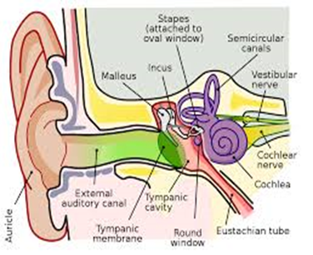
EAR

Slide 6
Ear
Tympanic membrane or ear drum
Ear pinna or auricle
Ear canal, external auditory meatus
Semicircular canal

Slide 7
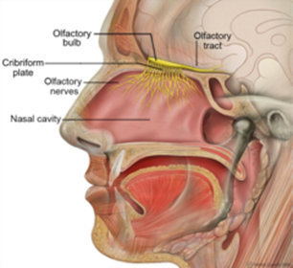
Nasal turbinate

Slide 8
Questions?

