Slide 1
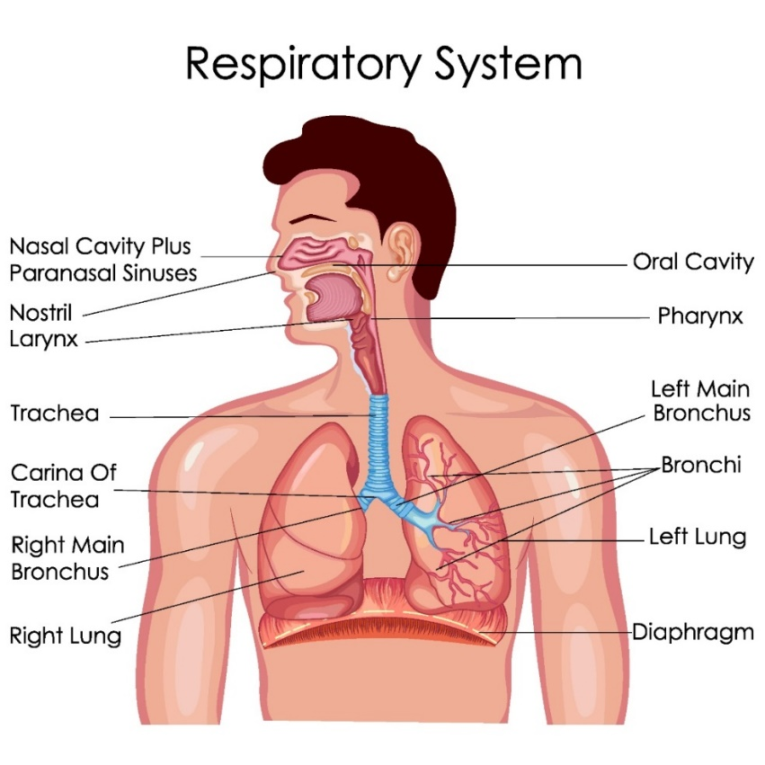
Chapter 3 Respiratory System

Slide 2
Trachea behind sternum has bifurcation at carina
Bronchus and bronchiole
Alveoli
Lung as pulmonary system
3 lobes on the right and 2 on the left

Slide 3
Pleura and pleural cavity
Anti-surfactant
Diaphragm in between the thoracic cavity and abdominal cavity

Slide 4
Urinary system
Kidney

Slide 5
Questions?

