Slide 1
Chapter 13 Test 1 Medical Vocabulary

Slide 3
Digestive system

Slide 6
Cardiovascular system

Slide 7
Reproductive system

Slide 8
Neurological system

Slide 9
Eye, ear, nose throat

Slide 10
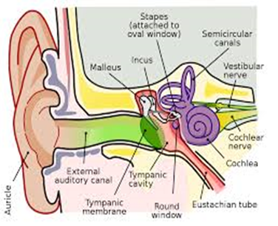
EAR

Slide 11
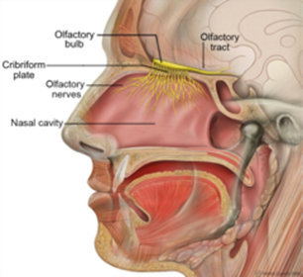
Nasal turbinate

Slide 12
Questions?

