Slide 1
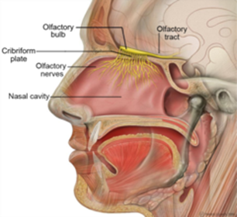
Chapter 11 Throat System

Slide 2
Questions?

