Slide 1
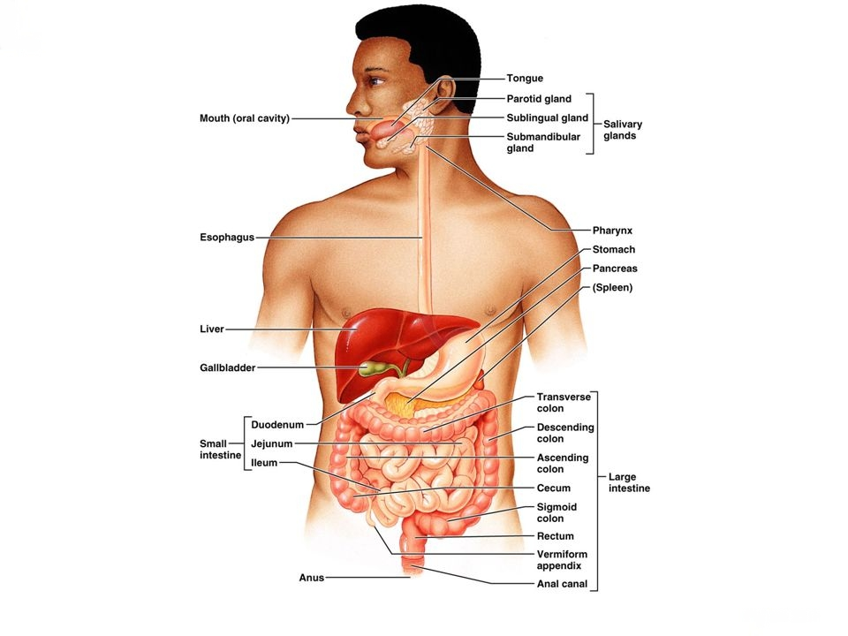
Chapter 2 Digestive system

Slide 2
Mouth or oral cavity and buccal mucosa
Tongue
Tooth as 20 milk teeth
32 teeth as incisor, canine, molar

Slide 3
Gum
Palate as hard palate and soft palate
Uvula
Tonsil
Acute tonsillitis

Slide 4
Salivary gland
Parotid gland
Submandibular gland
Sublingual gland
Pharynx

Slide 5
Esophagus
Peristalsis movement
Cardiac orifice

Slide 6
Stomach
Lesser curvature and greater curvature

Slide 7
1. Cardiac part or Cardia from esophagus
2. Fundus
3. Body
4. Pyloric part with pyloric sphincter

Slide 8
Small intestine are divided as duodenum, jejunum and ileum
Duodenum is the retroperitoneal organ
12 inches

Slide 9
Jejunum
Ileum
Large intestine as cecum, ascending colon, transverse colon, descending colon, sigmoid colon, rectum and anal canal

Slide 10
Cecum
5-7 cm
Ileocecal value
Vermiform appendix
Mc Burney’s point is the line from anterior superior iliac spine to umbilicus on the outer third
Tenderness and rebound tenderness of acute appendicitis

Slide 11
Ascending colon and hepatic flexor
Transverse colon and splenic flexor
Descending colon and sigmoid colon

Slide 12
Sigmoid colon
Rectum
Anal canal or anus

Slide 13
Liver beneath the diaphragm
Right lobe and Left lobe
Gall bladder

Slide 14
Pancreas is the retroperitoneal organ
Head of pancreas is and endocrine producing insulin and glucagon

Slide 15
Respiratory system
Nasal orifice and nasal septum
Nasal cavity
Sinus as frontal sinus, ethmoidal sinus, sphenoidal sinus and maxillary sinus

Slide 16
Nasal turbinate
Pharynx and Larynx
Epiglottis and vocal cord

Slide 17
Questions?

