Slide 1
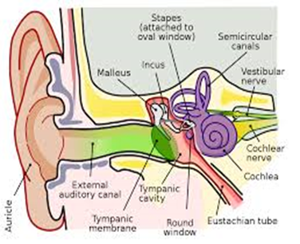
Chapter 9 EAR

Slide 2
Ear
Tympanic membrane or ear drum
Ear pinna or auricle
Ear canal, external auditory meatus
Semicircular canal

Slide 3
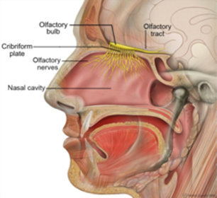
Nasal turbinate

Slide 4
Questions?

