Slide 1
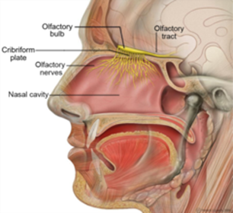
Chapter 10 Nasal turbinate

Slide 2
Questions?

