Slide 1
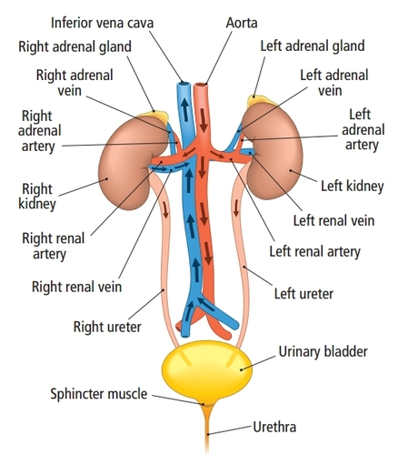
Chapter 4 Kidney System

Slide 2
Kidney is the retroperitoneal organ
From T12 to L3
Renal artery to glomerulus
Renal pelvis to ureter

Slide 3
Adrenal gland is an endocrine producing adrenaline, noradrenaline
and others steroid
Ureter is the retroperitoneal organ
Bladder trigone

Slide 4
Urinary bladder
Urethra
Urethral opening

Slide 5
Questions?

