Slide 1
MEDICAL CANNABIS
Panupan.sr@ssru.ac.th

Slide 2
agenda
INTRODUCTION 3
History 4
Science of Cannabinoids & Endocannabinoids • 5
Medical –Political & Legal Issues 10
SUMMARY 13

Slide 3

introduction
Cannabis, má麻(hemp; ma-Spanish; numbness) or dàmá大麻(with "big; great")
•Chinese, used hemp for fiber starting ~10,000 yrs ago
•麻醉, má zui Chinese term for anesthesia
•2900 BC-Chinese Emperor Fu Hsi References cannabis as a Popular Medicinethat possessed both yin and yang
•In 2008 Yanghai Tombs, Xinjiang-Uighur Region, China have been excavated the 2700-yr-old grave of a Caucasoid shaman whose accoutrements included a large cache [~2 pounds] of cannabis..
•These provide the oldest documentation of cannabis as a pharmacologically active agent, and contribute to the medical and archaeological record of this pre-Silk Road culture."

Slide 4
Emperor Shen-Nun
Emperor Shen-Nung, also a pharmacologist, wrote a book (circa 2700 B.C), medical benefits of cannabis, including constipation, gout, rheumatism, and absent-mindedness.
•discovered its healing properties as other 2 other mainstays of Chinese herbal medicine, ginseng and ephedra.”

Slide 5
Hua Tuo
Hua Tuo (c. 140–208) was a Chinese physician from the late Eastern Han Dynasty. The historical texts Records of the Three Kingdoms and Book of the Later Han record Hua Tuo as the first person in China to use anaesthesia during surgery. He used a general anaesthetic combining wine with a herbal concoction called ma-fei-san (麻沸散, lit. "cannabis boil powder").

Slide 6
The Ebers Papyrus
The Ebers Papyrus(ca. 1550 BCE) from ancient Egypt has a prescription for medical marijuana applied directly for inflammation
1213 BC-Egyptians Use Cannabis for Glaucoma, Inflammation, and Enemas

Slide 7
History of Marijuana
Cannabis probably originated in China. Medical and religious use can be traced to ancient China, India, and the Middle East, spreading to the Arab world.
•Napoleon’s soldiers brought it to France from Egypt. It became popular with French writers and artists.
•Hemp was grown in colonial America, but marijuana smoking probably came to the U.S. with Mexican and Caribbean immigrants in the early 1900s.

Slide 8
Cannabis
C. sativa –tall thin narrower leaves and grow a lighter green in color. They grow very quickly and can reach heights of 20 feet in a single season. They originally come from Colombia, Mexico, Thailand and Southeast Asia.
•C. indicaoriginally come from the hash producing countries of the world like Afghanistan, Morocco, and Tibet. They are short dense plants, with broad leaves and often grow a darker green.
•C. indica has lower THC, higher CBN/CBD
•C.ruderalisRussia, Eastern Europe. Has lower THCcontent than either C. sativaor C. indica

Slide 9
The chemical makeup of cannabis
The active ingredients in cannabis are cannabinoids, a group of terpenophenolic compounds.
•The cannabinoids are concentrated in a viscous resin that is produced in glandular structures known as trichomes, these are the tiny, sticky hair like formations at the end of buds.

Slide 10
Cannabinoids
Cannabis contain ~500 chemicals
•Compounds with a skeleton made of a resorcinol type ring with a terpene moiety derivative attached to it (around 70 identified)
•80+ cannabinoids(21-carbon molecule)
•Among cannabinoids, THC and Cannabidiol (CBD) are the most abundant.

Slide 11
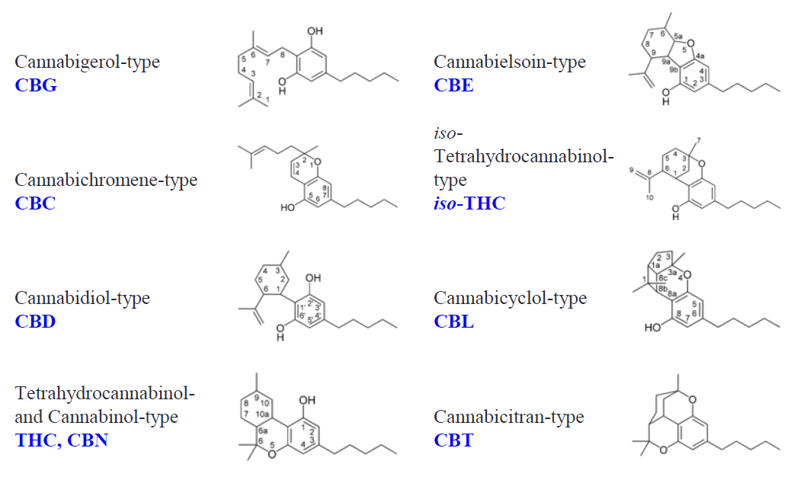
Phytocannabinoids

Slide 12
THC (Delta-9-Tetrahydrocannabinol)
1964 -THC, Main Psychoactive Component of Cannabis, First Identified and Synthesized by Dr. Raphael Mechoulam, Professor of Medicinal Chemistry at the Hebrew University of Jerusalem
•He is the first to identify delta-9-tetrahydrocannabinol (THC), as the main psychoactive component of cannabis.
•Effects of THC are included among the effects of marijuana, but not all the effects of marijuana are necessarily due to THC
•Delta-9-THC and Delta-8-THC are the only compounds in the marijuana plant that produce all the psychoactive effects of marijuana.

Slide 13
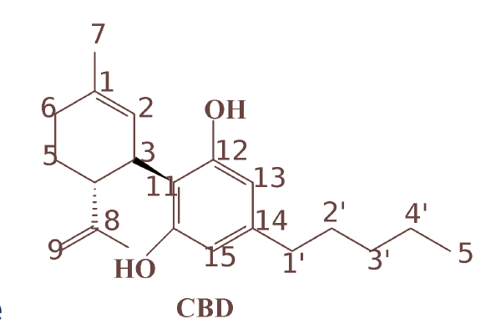
Pharmacological Effects of CBD
Anticonvulsant
•Analgesic
•Anti-anxiety
•Anti-psychotic
•Anti-inflammatory
•Anti-arthritic
•Immunosuppressive

Slide 14

summary
•”28yrs after discovering THC, in 1992, Dr. Mechoulam, Dr. William Devane and Dr. Lumir Hanus, identified the brain's first endogenous cannabinoid (or endocannabinoid) -the brain's natural version of THC -which they called ‘Anandamide,' from the Sanskrit word 'ananda,' (means 'eternal bliss' or 'supreme joy.
•ECS is a group of neuromodulatory lipidsand their receptorsin the brain that are involved in a variety of physiological processes including appetite, pain-sensation, mood, and memory;
•It mediates the psychoactive effects of cannabis
•Vigorous exercise stimulates the release of anandamide, and the sense of euphoric well-being that comes with a healthy workout

Slide 15
thank you

